Slide 1
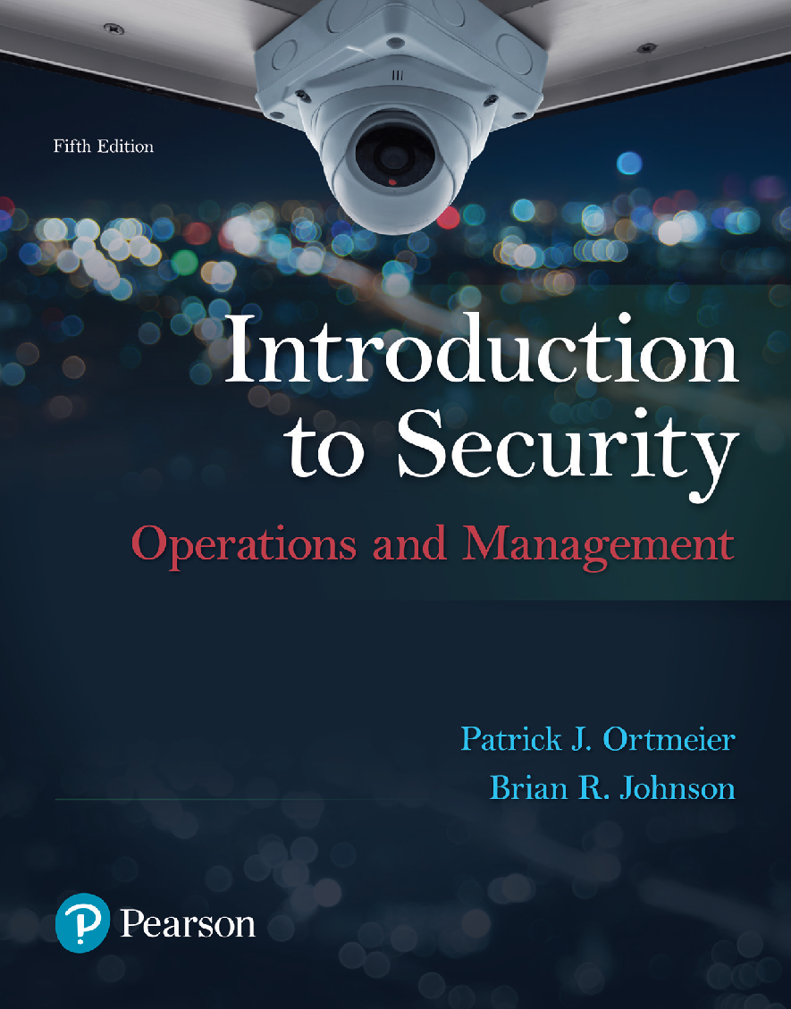
Introduction to Security: Operations & Management
5th Edition
Chapter 13
Security in an International Perspective

Slide 2
Learning Objectives (1 of 2)
1. Identify the main social and political factors that led to the growth of private security throughout the world
2. Explain how the private security industry is regulated and controlled in other regions of world, compared to the United States
3. Assess the quality of the private security industry throughout the world
4. Compare and contrast security needs and practices throughout the world
5. Identify some unique private security activities throughout the world
Notes:
Slide 2 is list of textbook LO numbers and statements

Slide 3
Learning Objectives (2 of 2)
6. Explain some of the key deficiencies in the regulation of private security companies in various regions of the world
7. Explain the role of Private Security Military Companies
8. Identify major issues related to the use of Private Security Military Companies
9. Understand the nature and extent of maritime piracy and various ways secure maritime shipping
10. Explain the various private and public organizations involved in the regulation and control of private security companies throughout the world
Notes:
Slide 2 is list of textbook LO numbers and statements

Slide 4
Introduction

Slide 5
The Private Security Industry in Europe
(1 of 5)
The Former USSR:
  Key Points
  Issues

Slide 6
The Private Security Industry in Europe
(2 of 5)
Yugoslavia & Southern Eastern Europe:
  Key Points
  Issues

Slide 7
The Private Security Industry in Europe
(3 of 5)
Other Nations in South Eastern Europe:
  Key Points
  Issues

Slide 8
The Private Security Industry in Europe
(4 of 5)
European Union:
  Key Points
  Confederation of European Security Services
  Issues

Slide 9
The Private Security Industry in Europe
(5 of 5)
The United Kingdom:
  Key Points
  Security Industry Authority
  Public Private Partnerships

Slide 10
The Private Security Industry in Africa
Main Points:
Issues/Concerns:

Slide 11
The Private Security Industry in Central & South America
Main Points:
Issues/Concerns:

Slide 12
International Issues & Private Security (1 of 4)
High Seas Piracy:
  Introduction/Definition
  Nature & Extent
  High Risk Areas
  Motives

Slide 13
International Issues & Private Security (2 of 4)
High Seas Piracy (continued):
  Security Countermeasures
  International Agreements

Slide 14
International Issues & Private Security (3 of 5)
Private Military Security Companies (PMSCs):
  Introduction/Definitions
  History
  Benefits

Slide 15
International Issues & Private Security (3 of 4)
Private Military Security Companies (continued):
  Issues
  PMSCs & the Global War on Terror

Slide 16
Regulating the International Private Security Industry (1 of 2)
Introductions/Definitions:
The Montreux Document:

Slide 17
Regulating the International Private Security Industry (2 of 2)
International Code of Conduct (ICoC):
The United Nations:

Slide 18
Career Opportunities
Private Military Security Companies:

